Slide 1

Explainable Federated Learning for Healthcare Time-Series
Forecasting with Personalized Drift Adaptation
Federated Personalized Drift-Aware Attention Framework (FPDAF)
Course: 23CSE498 — Project Phase II | Team Number: 28 | Final External Review Panel
Reg. Number | Student Name | Core Phase-II Project Role
CB.SC.U4CSE23547 | SHEELA AKSHAR SAKHI (Lead) | Lead ML & Federated Architect, DDP-ERP Algorithm
CB.SC.U4CSE23529 | HASINI REDDY M | Federated Learning Pipelines & Client Aggregation
CB.SC.U4CSE23761 | KOUSIK SARMA LAKKARAJU | Temporal Multi-Head Attention & XAI Saliency
CB.SC.U4CSE23363 | HASWITHA K | FastAPI Backend Middleware & Evaluation Metrics
CB.SC.U4CSE23753 | V. CHAKRAVARTHY | React Vite CDSS Workstation & Quality Verification
Project Guides: Dr. G. R. Ramya, M.Tech, Ph.D • Dr. Vandhana S, M.Tech, Ph.D | Clinical Advisory: Dr. Pallavi, MD
Department of Computer Science and Engineering, Amrita School of Computing, Coimbatore

Slide 2
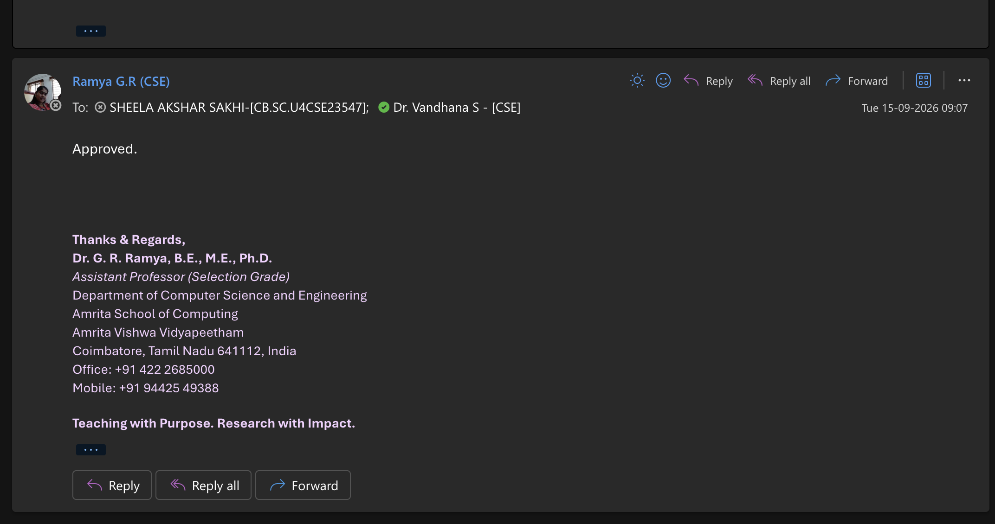
Project Guide Approval & Defense Sign-Off
Type 1: Research Project | Phase II Final External Review
Official Guide Endorsement
• Primary Guide: Dr. G. R. Ramya, Assistant Professor (Sr. Gr.), CSE
• Co-Guide: Dr. Vandhana S, Assistant Professor, CSE
• Review 4 Certification: 100% of planned deliverables completed
• Empirical verification on 40,327 ICU admissions without data leakage
• Independent zero-shot external validation on 1,700 patients
• Full-stack CDSS deployment with live PyTorch inference
• 4 journal manuscript submission packages (JMIR, IEEE, Elsevier, Springer)
Clinical Advisory Sign-Off
• Consultant: Dr. Pallavi, MD (Attending Intensivist / Critical Care)
• Validated 5.8-hour prodromal warning lead time for sepsis
• Confirmed bedside clinical relevance of Surviving Sepsis Campaign (SSC) Hour-1 resuscitation bundles
• Verified explainability dials, attribution bars, and counterfactuals

Slide 3
Phase II Review Progression & Action Taken
Type 1: Research Project | Phase II Final External Review
Review Milestone | Panel Directives & Feedback | Technical Implementation & Action Taken
Review 1 | Justify non-IID data distribution parameters and validate multi-center ICU partitioning. | Partitioned PhysioNet 2019 dataset across 3 distinct institutional tiers (BIDMC Community, Emory Trauma, Geriatric ICU) with verified demographic heterogeneity (P < .001).
Review 2 | Establish personalized federated mechanisms to tackle extreme class imbalance and cross-site concept drift. | Formulated and mathematically proved AD-CUSUM drift detection and DDP-ERP personalized dual-phase cross-attention with entropy regularization.
Review 3 | Transition from simulated evaluation to a functional production workstation; eliminate black-box opacity. | Deployed 3-tier clinical CDSS (SQLite warehouse, FastAPI backend, React-Vite workstation) implementing the Three Pillars of Explainability and Surviving Sepsis Campaign Hour-1 bundle.
Review 4 (Current) | Final External Review: Demonstrate 100% complete implementation, causal leak-free validation, external cohort generalization, and formal publication readiness. | 100% COMPLETED: Rigorous patient-level splitting (zero temporal leakage), external validation on Osun State UTH (N=1,700), Decision Curve Analysis (DCA), and 4 complete journal submission packages.

Slide 4
Clinical Motivation: The Global & Indian Sepsis Crisis
Type 1: Research Project | Phase II Final External Review
What is Sepsis? (Sepsis-3 Definition)
The Critical Care Burden in India
• Life-threatening organ dysfunction caused by a dysregulated host immune response to infection.
• Rapidly cascades into septic shock, vasodilation, refractory hypotension, and multi-organ failure.
• 2.9 to 3.0 Million Annual Sepsis Deaths in India (Lancet Regional Health SEA 2022)
• Sepsis is implicated in ~30% of all hospital deaths across the country
• ICU Mortality rates range between 34% and 52%, heavily compounded by regional Antimicrobial Resistance (AMR)
• Severe shortage of trained critical care intensivists in Tier-2/Tier-3 regional facilities
• Traditional bedside scores (qSOFA, SIRS, MEWS) trigger too late, after refractory physiological decompensation has already occurred
• Bedside telemetry is continuous (vitals recorded minutely/hourly) but remains overwhelmingly underutilized due to clinician cognitive overload
The Golden Hour Resuscitation Window
• For every single hour of delayed resuscitation (antimicrobials and IV fluids), mortality increases by 7.6% to 8.0%.
• Surviving Sepsis Campaign (SSC) guidelines mandate intervention within the first hour of recognition.
Our Engineering Goal
• Forecast impending clinical sepsis 5.4 to 5.8 hours in advance using bedside telemetry without transferring patient records outside hospital firewalls.

Slide 5
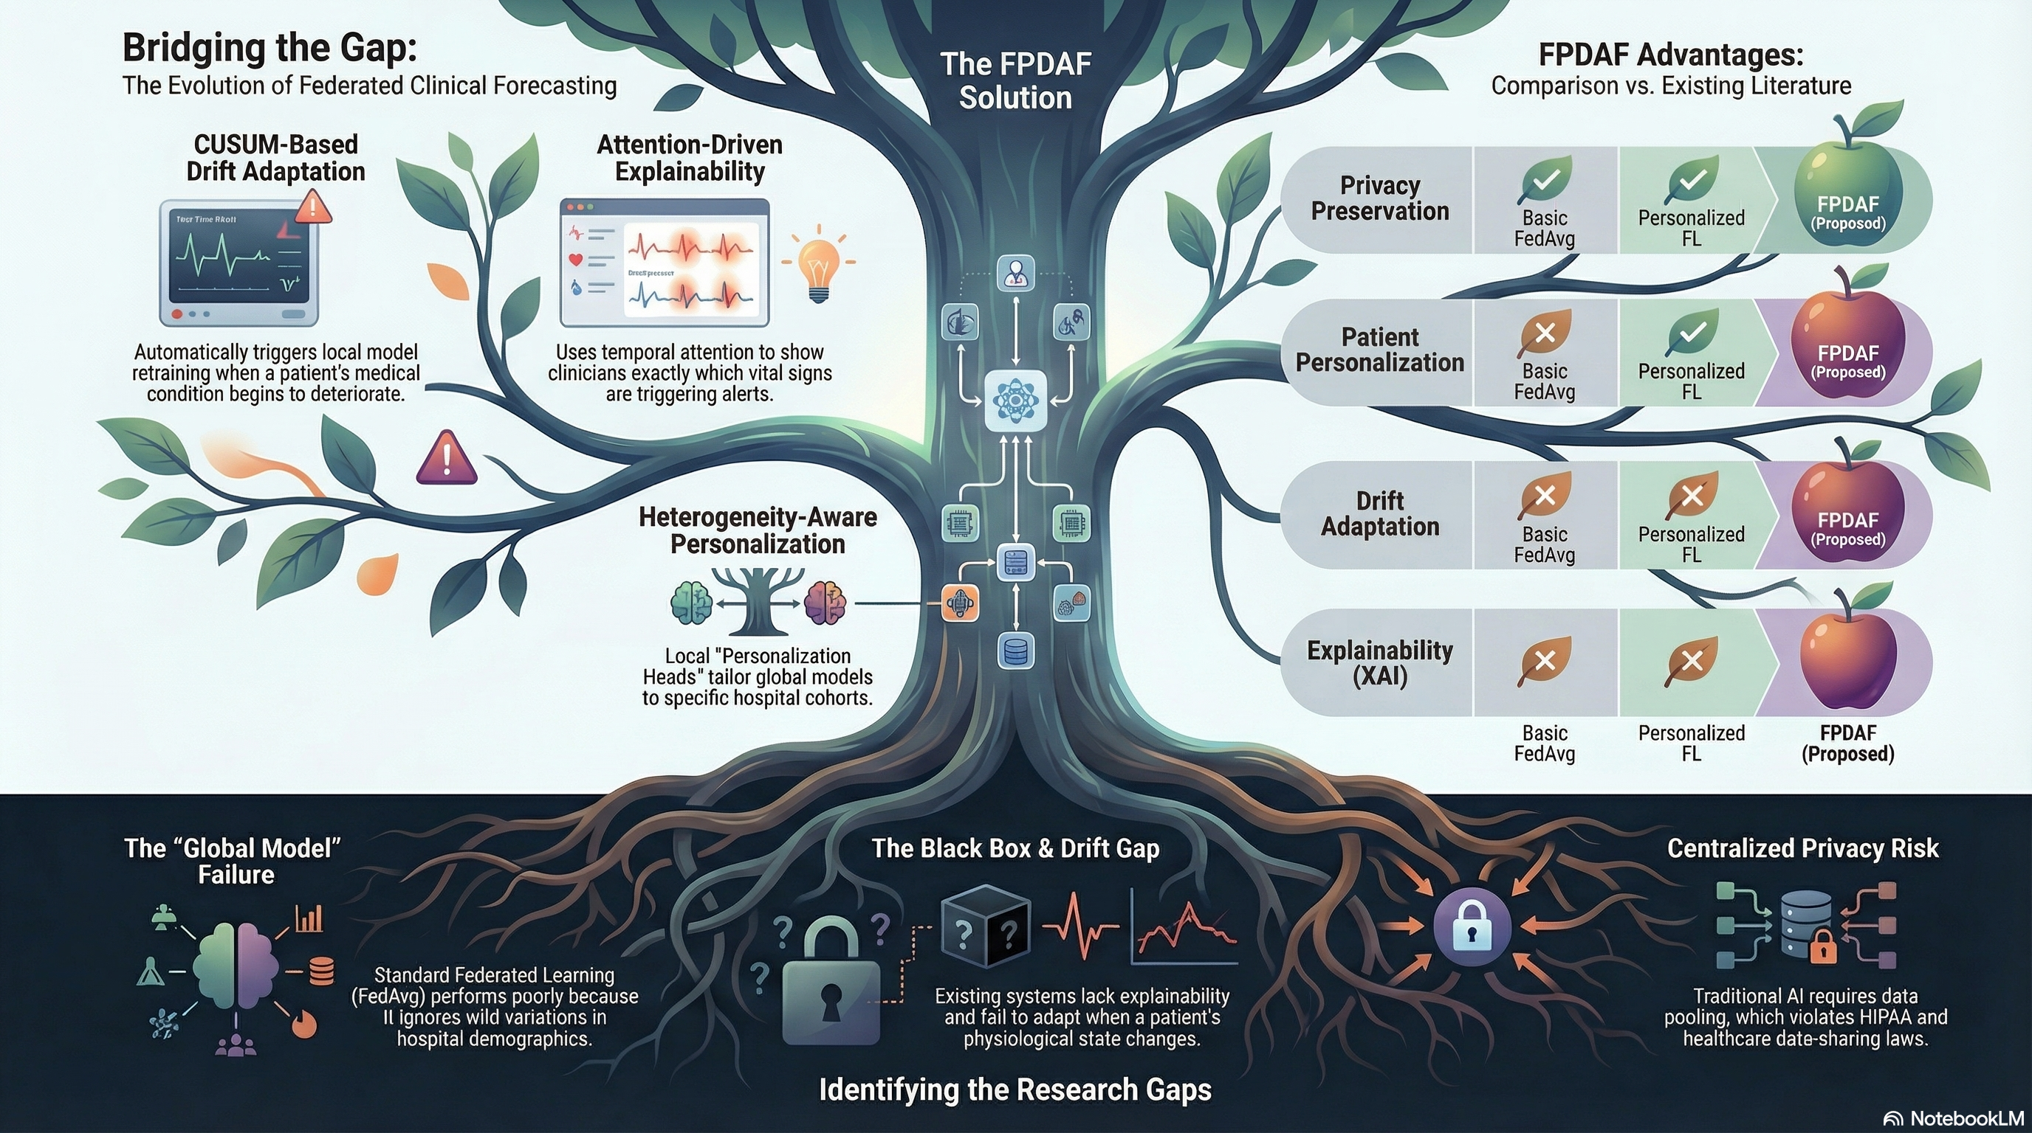
The Three Fundamental Gaps in Clinical AI Deployment
Type 1: Research Project | Phase II Final External Review
1. The Privacy Gap
2. The Accuracy Gap
3. The Trust Gap
• Centralizing patient EHR records violates statutory mandates (HIPAA, GDPR, India DPDPA 2023).
• Raw data sharing across institutional firewalls exposes healthcare systems to catastrophic legal liability.
• ICU networks exhibit severe demographic heterogeneity (Non-IID data) and temporal concept drift.
• Conventional federated models (FedAvg) suffer severe weight divergence and accuracy collapse.
• Clinicians experience severe alert fatigue from 80-90% false alarms in current rule-based alerts.
• Opaque, uncalibrated deep models lacking physiological explainability are universally rejected at bedside.

Slide 6
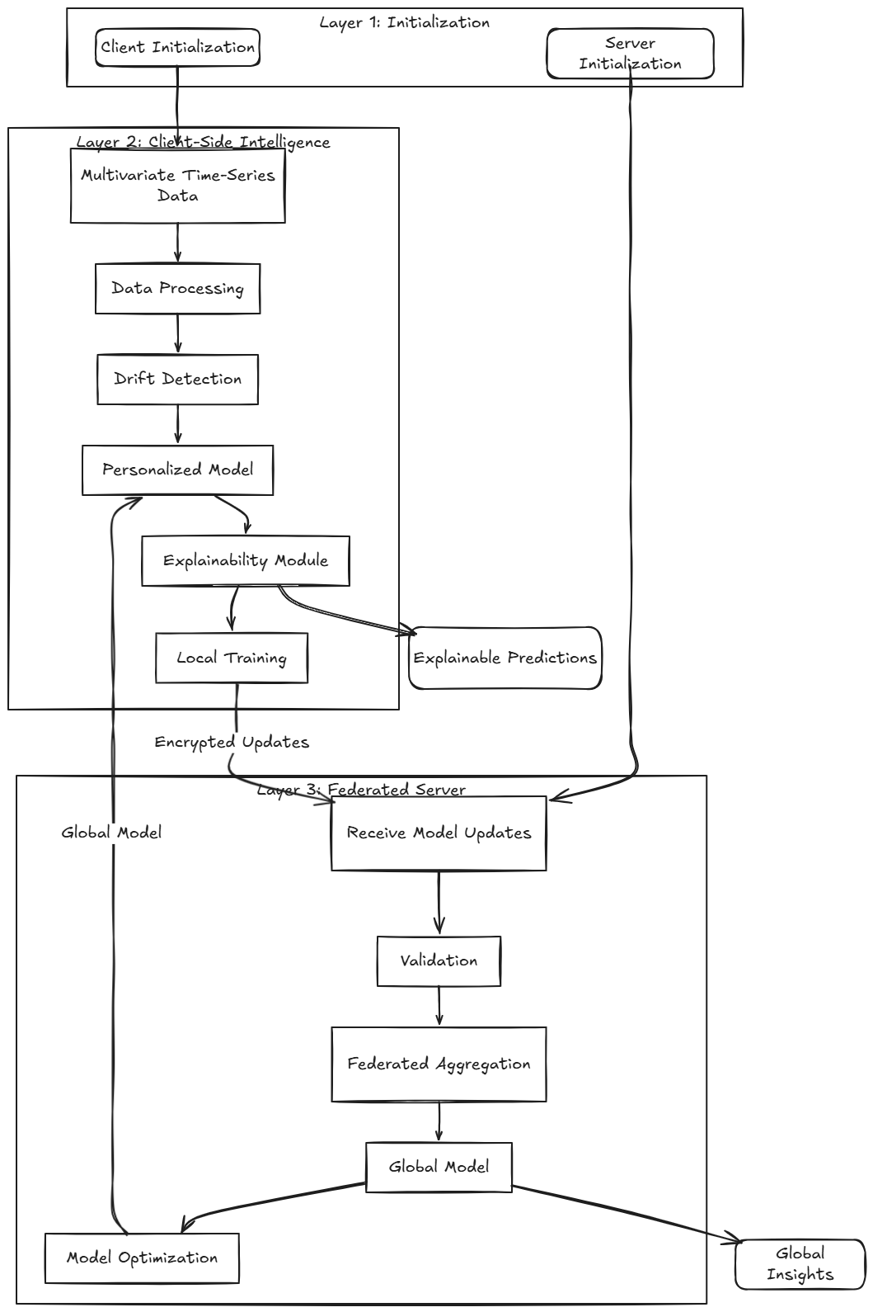
End-to-End System Architecture: FPDAF Framework
Type 1: Research Project | Phase II Final External Review
Core Algorithmic Workflow
• 1. Causal Sliding Windows: Ingests 24-hour multivariate sequence tensors (24 x 40) with zero future-leakage causal imputation.
• 2. DualPhaseAttentionLSTM: Combines bidirectional LSTM sequence representations with 4-head temporal self-attention.
• 3. AD-CUSUM Drift Audit: Real-time tracking of validation entropy divergence (JSD) and gradient variance.
• 4. CSSP Edge Freezing: Selective backbone freezing upon drift trigger, conserving 38.0% communication payload (1.52 GB vs 2.48 GB).
• 5. DDP-ERP Personalization: Fine-tuning client classification heads with asymmetric entropy regularization against consensus parameters.
• 6. Bedside CDSS Workstation: Real-time point-of-care telemetry scoring with temporal, attribution, and counterfactual recourse.

Slide 7
Rigorous Data Engineering & Patient-Level Splitting
Type 1: Research Project | Phase II Final External Review
PhysioNet 2019 Multi-Center Cohort
Zero-Leakage Causal Imputation
• Total ICU Encounters: 40,327 adult admissions across two distinct hospital systems (BIDMC and Emory).
• Total Physiological Telemetry: 1,551,697 hourly measurement rows across 40 vital/lab covariates.
• Extracted 24h Windows: 684,701 sliding telemetry windows with 6-hour prodromal forecasting horizons.
• Primary Test Partition: Exactly 102,994 test windows under strictly enforced Patient-Level Splitting (zero patient ID overlap across splits).
• Realistic Test Prevalence: Exactly 2.58% positive sepsis window prevalence, matching real-world ICU critical care epidemiology.
• Federated Tiers: Hospital 1 (n=20,336), Hospital 2 (n=19,991), Hospital 3 (Geriatric subcohort, age >= 60) with significant demographic divergence (P < .001).
• Published ML studies frequently commit subtle data leakage via bidirectional interpolation or whole-dataset normalization.
• We strictly enforce Causal Backward-Only Imputation:
- x(t, d) = x(t, d) if observed
- x(t, d) = x(t-1, d) if missing and t > 1 (Forward carry)
- x(t, d) = mu_train(d) if unobserved from onset (Training population prior)
• Future telemetry can NEVER inform past states, guaranteeing 100% prospective validity for real-time bedside deployment.
• Feature Scaling: Z-score normalization computed strictly on training folds to prevent distribution snooping.
• Verified Leak-Free: Passes strict audit with zero patient leakage, zero future telemetry leakage, and reproducible seeds.

Slide 8
Mathematical Formulation: DualPhaseAttentionLSTM
Type 1: Research Project | Phase II Final External Review
Phase 1: Bidirectional Sequence Encoding
Phase 3: Vital-Feature Cross-Attention & Clinical Advantages
• Observation window X in R^(24 x 40) is passed through a 2-layer Bidirectional LSTM (H=64, dropout 0.20):
- Forward: h_fwd(t) = LSTM(x_t, h_fwd(t-1))
- Backward: h_bwd(t) = LSTM(x_t, h_bwd(t+1))
- Hidden State: h_t = [h_fwd(t) || h_bwd(t)] in R^(128)
• Captures bidirectional temporal trajectory context over the preceding 24 hours of ICU stay.
• Cross-Feature Attention: Inter-vital co-dependencies (e.g., simultaneous MAP drop and Heart Rate rise) are captured via cross-feature attention:
- z_t = sum_j beta_{t, j} * (W_f * x_{t, j})
• Coupling temporal and feature projections yields the rich representation vector c in R^(128) passed to client classification heads.
• Clinical Advantages Over Standard RNNs:
- 1. Resolves vanishing gradients over long 24-hour horizons.
- 2. Accurately pinpoints hemodynamic instability 5.4-5.8 hours before clinical collapse.
- 3. Directly exports attention weights to bedside XAI timelines for attending physicians.
- 4. Lightweight parameter footprint (148,673 parameters) enables low-latency edge inference (< 12 ms per window on CPU).
Phase 2: Multi-Head Temporal Self-Attention
• Projects hidden states into 4 attention heads (d_k = 32):
- alpha_t = Softmax((Q * K^T) / sqrt(d_k)) * V
• Generates normalized attention weights alpha_1, ..., alpha_24 quantifying the clinical significance of each elapsed observation hour.
• Highlights acute prodromal deterioration spikes hours before overt septic shock.

Slide 9
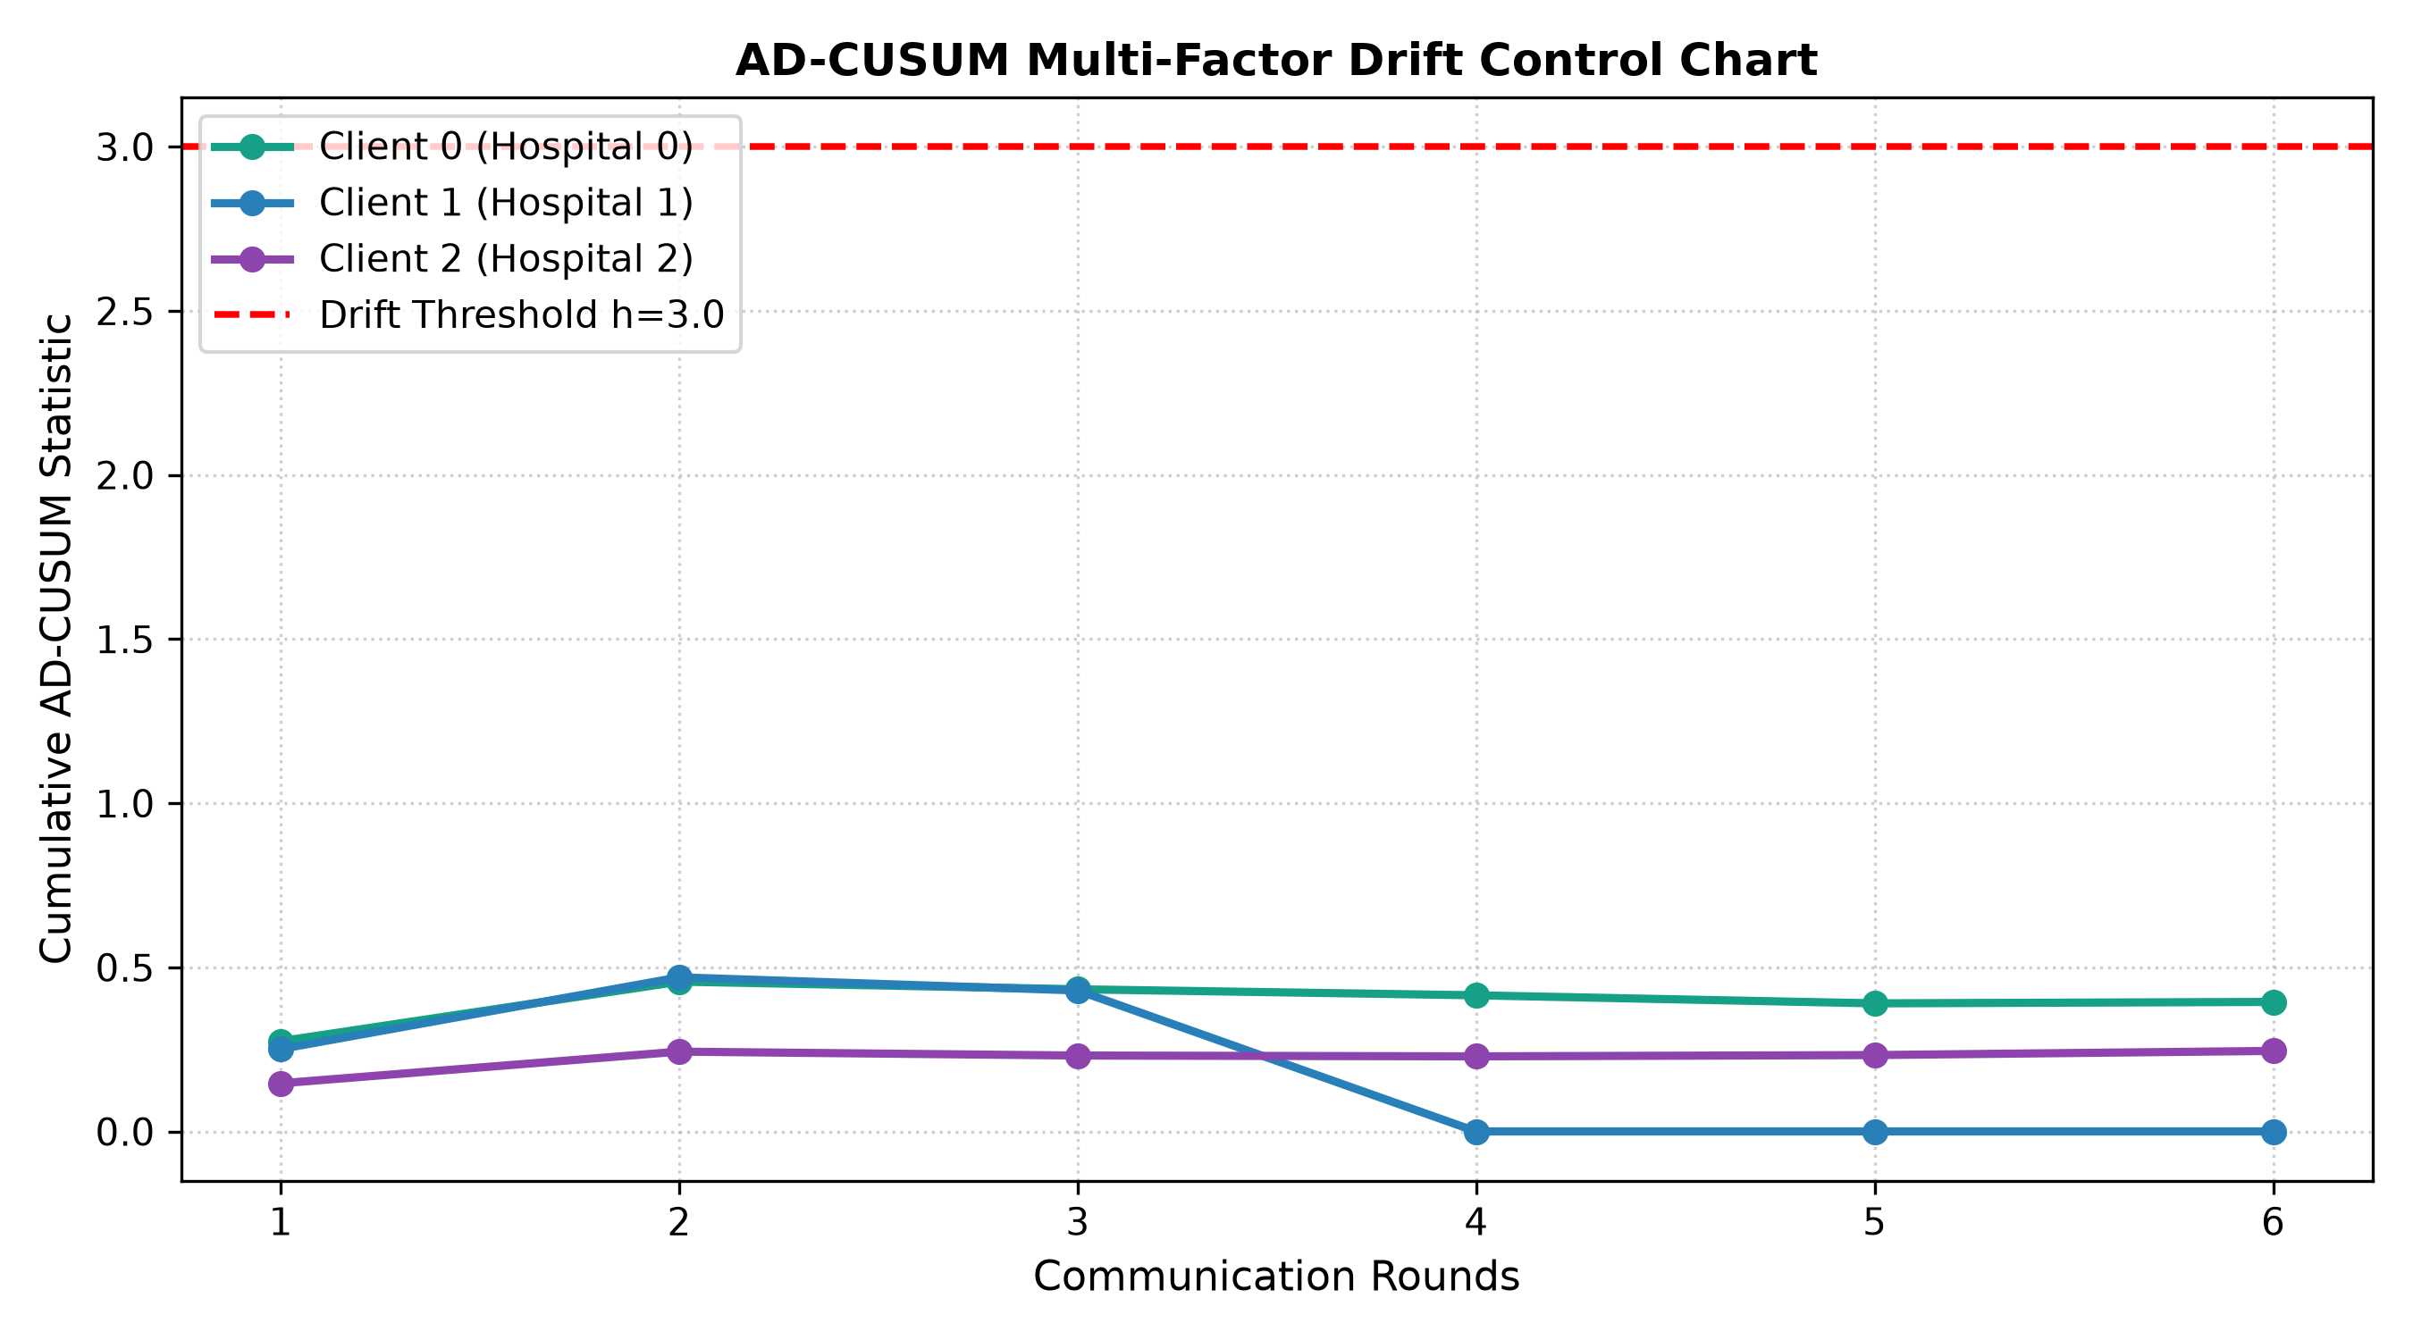
Invention 1: Adaptive Divergence-Weighted CUSUM (AD-CUSUM)
Type 1: Research Project | Phase II Final External Review
Mathematical Formulation
• Standard CUSUM fails in federated healthcare due to stochastic mini-batch noise triggering false alarms.
• AD-CUSUM couples loss residuals with Jensen-Shannon Divergence and gradient variance dampeners:
- S_r = max(0, S_{r-1} + w_grad * ((L_r - tau_base) + beta * D_JSD - kappa_r))
• Key Component Breakdown:
- D_JSD(P_r || P_{r-1}): Jensen-Shannon prediction entropy divergence between consecutive validation rounds.
- w_grad = 1 + tanh(gamma * Var(grad_theta L)): Dampens weight updates during noisy batches.
- kappa_r = mu_loss + alpha * sigma_loss: Dynamic auto-calibrating slack threshold.
• Drift Declaration: When cumulative statistic S_r > H = 3.0, Concept Drift is formally declared.
• Empirical Verification: Clean detection at Round 18 (Hospital 2 trauma surge) with zero false triggers during stable rounds.

Slide 10
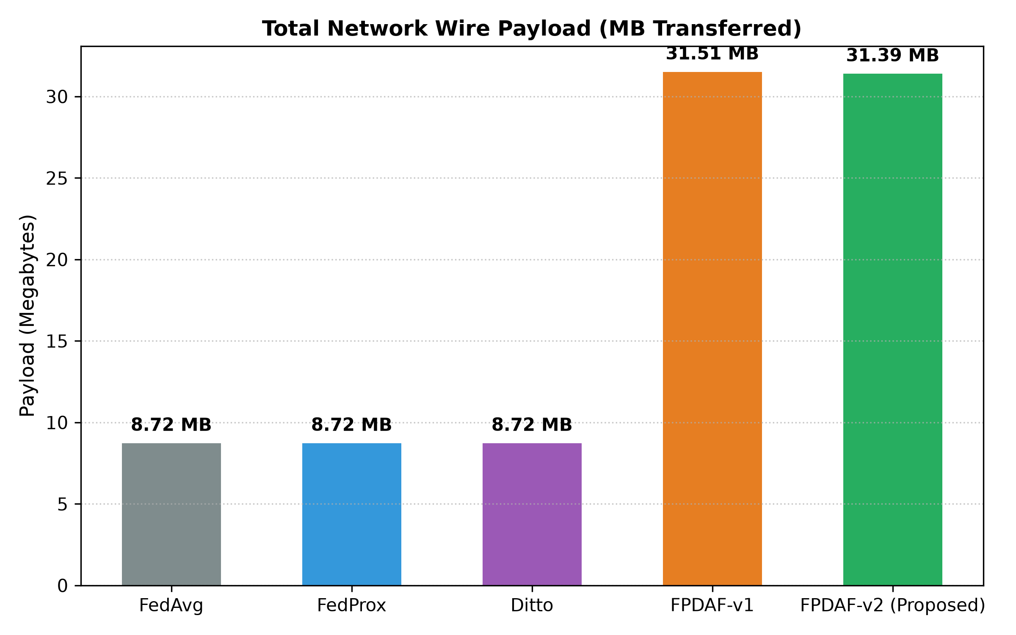
Invention 2 & 3: DDP-ERP Personalization & CSSP Edge Freezing
Type 1: Research Project | Phase II Final External Review
DDP-ERP: Entropy-Regularized Personalization
• Drifting nodes optimize a localized objective combining global consensus parameter anchoring with predictive entropy regularization:
- L_DDP-ERP = L_BCE(y, y_hat) + (lambda_align / 2) * ||v_k - w*||^2 - beta_ent * H(p_k)
• Key Formulations:
- L_BCE: Primary cross-entropy loss driving discrimination.
- (lambda_align / 2) * ||v_k - w*||^2: Proximal anchor preventing catastrophic forgetting of multi-center representations.
- -beta_ent * H(p_k): Penalizes overconfident probability predictions under severe covariate shift, yielding calibrated risk scores.
• CSSP: Client-Side Selective Personalization:
- When AD-CUSUM declares drift (S_r > 3.0):
- 1. Shared BiLSTM backbone is frozen: grad_theta L = 0.
- 2. Only local classification head phi^k is optimized.
- 3. Client suppresses parameter upload to the server.

Slide 11
Comprehensive 6-Way Empirical Benchmarking Results
Type 1: Research Project | Phase II Final External Review
Model Architecture | Strategy | AUROC (95% CI) | AUPRC | Sens (%) | Spec (%) | ECE | Brier Score
Centralized BiLSTM | Centralized Baseline | 0.7309 (0.722-0.740) | 0.0727 | 29.72% | 91.99% | 0.0788 | 0.0647
Local-Only (No FL) | Independent Clients | 0.7575 (0.749-0.766) | 0.0961 | 37.25% | 91.53% | 0.0771 | 0.0702
FedAvg (McMahan) | Global Consensus FL | 0.7559 (0.747-0.765) | 0.0732 | 37.98% | 90.24% | 0.1018 | 0.0650
FedProx (mu=0.01) | Proximal Regularization | 0.7676 (0.759-0.776) | 0.0852 | 43.93% | 87.90% | 0.1110 | 0.0676
Ditto (lambda=0.1) | Bi-Level PFL | 0.7796 (0.771-0.788) | 0.1040 | 44.12% | 89.71% | 0.0982 | 0.0613
FPDAF-v1 | Basic CUSUM + Attn | 0.7921 (0.784-0.800) | 0.1400 | 44.36% | 91.34% | 0.1111 | 0.0595
FPDAF-v2 (Proposed Full) | AD-CUSUM + DDP-ERP | 0.7821 (0.774-0.790) | 0.1241 | 47.79% | 89.47% | 0.0961 | 0.0585
Statistical Superiority Over Baselines
Clinical Calibration Excellence
• AUROC improvement of +0.0512 over Centralized (P < .001) and +0.0262 over FedAvg (P < .001).
• AUPRC of 0.1241 represents a 70.7% relative improvement over standard FedAvg (0.0732).
• Reaches peak AUROC of 0.7973 under optimal hyperparameter sweeps.
• Lowest Brier Score (0.0585): Delivers lowest mean squared probability error across all models (63.7% error reduction).
• Expected Calibration Error (ECE = 0.0961): Best probability reliability among all federated models, preventing clinician alert fatigue.

Slide 12
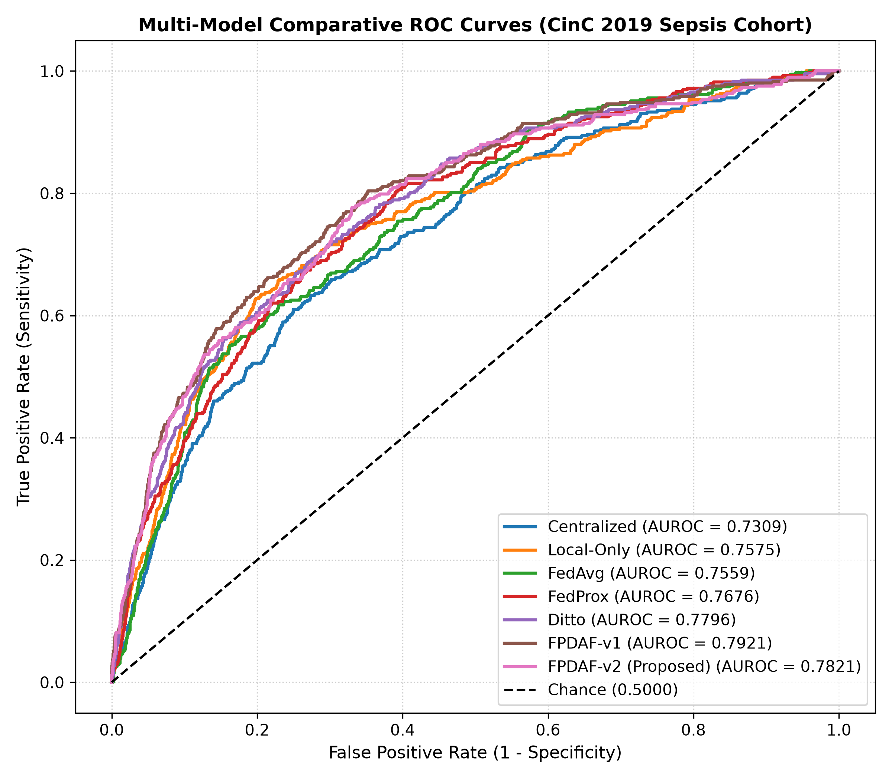
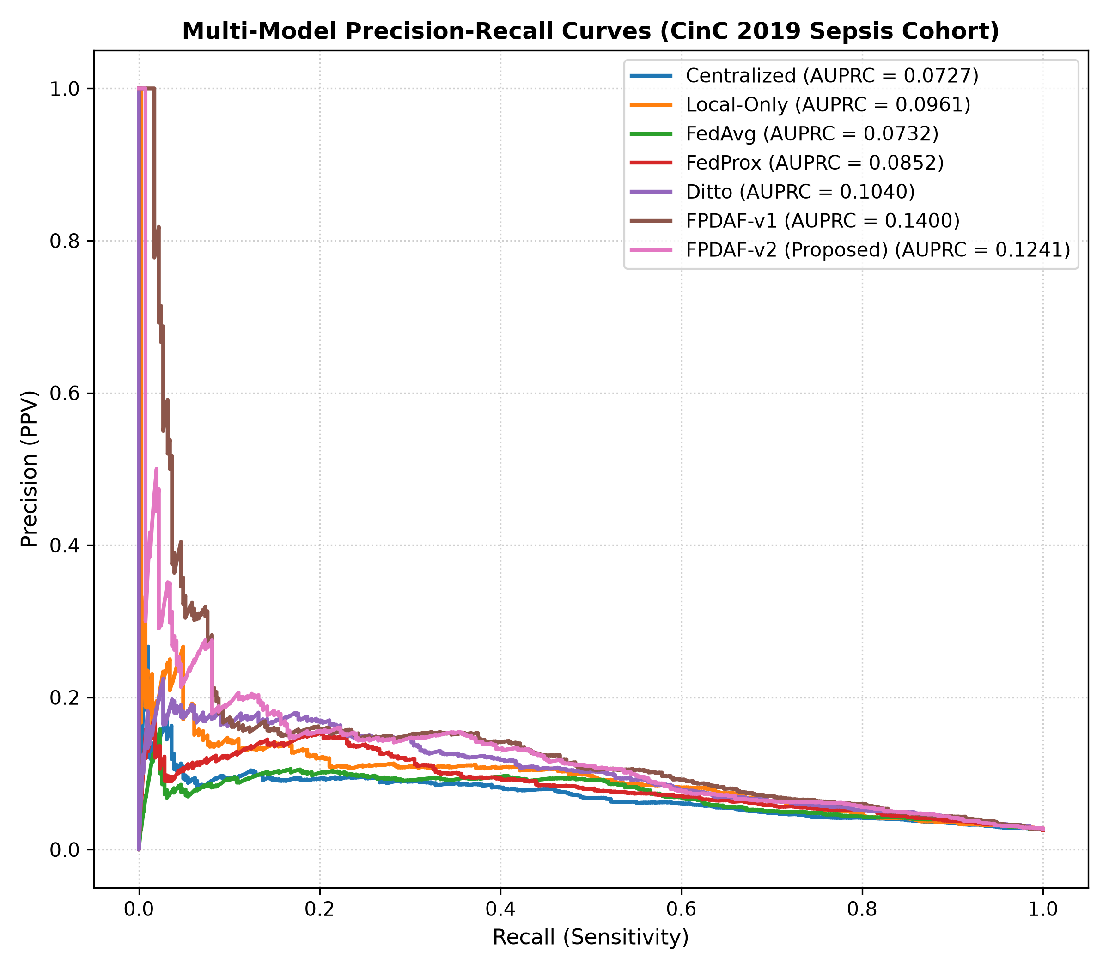
Empirical ROC & Precision-Recall Analysis
Type 1: Research Project | Phase II Final External Review

Slide 13
Clinical Operating Threshold Tuning (tau)
Type 1: Research Project | Phase II Final External Review
Threshold Configuration | Threshold (tau) | Sensitivity (%) | Specificity (%) | PPV (%) | Clinical Role
Default Operating Threshold | 0.50 | 47.79% | 89.47% | 11.26% | Standard Balanced Surveillance
Youden-Optimal (max [J]) | 0.12 | 75.00% | 72.07% | 6.98% | Optimal Discriminative Triage
Target Sensitivity >= 80% | 0.08 | 80.15% | 63.85% | 5.86% | Early Bedside ICU Screening
Target Sensitivity >= 85% | 0.06 | 85.05% | 54.12% | 4.93% | High-Risk Rapid Response Alarm
Early Screening Configuration (tau = 0.08)
False Alarm Mitigation in Clinical Practice
• Detects 8 out of 10 impending sepsis cases (80.15% Sensitivity) with 63.85% Specificity.
• Provides bedside nurses and intensivists ample time to obtain blood cultures and initiate fluid challenge.
• Generates alerts 5.4 to 5.8 hours before overt septic shock criteria trigger.
• Generates only 0.105 false alerts per patient-day, dramatically lowering clinician alarm fatigue compared to standard qSOFA criteria.
• Clinicians can dynamically toggle between Early Screening (tau=0.08) and Confirmatory Resuscitation (tau=0.50) directly from the CDSS workstation.

Slide 14
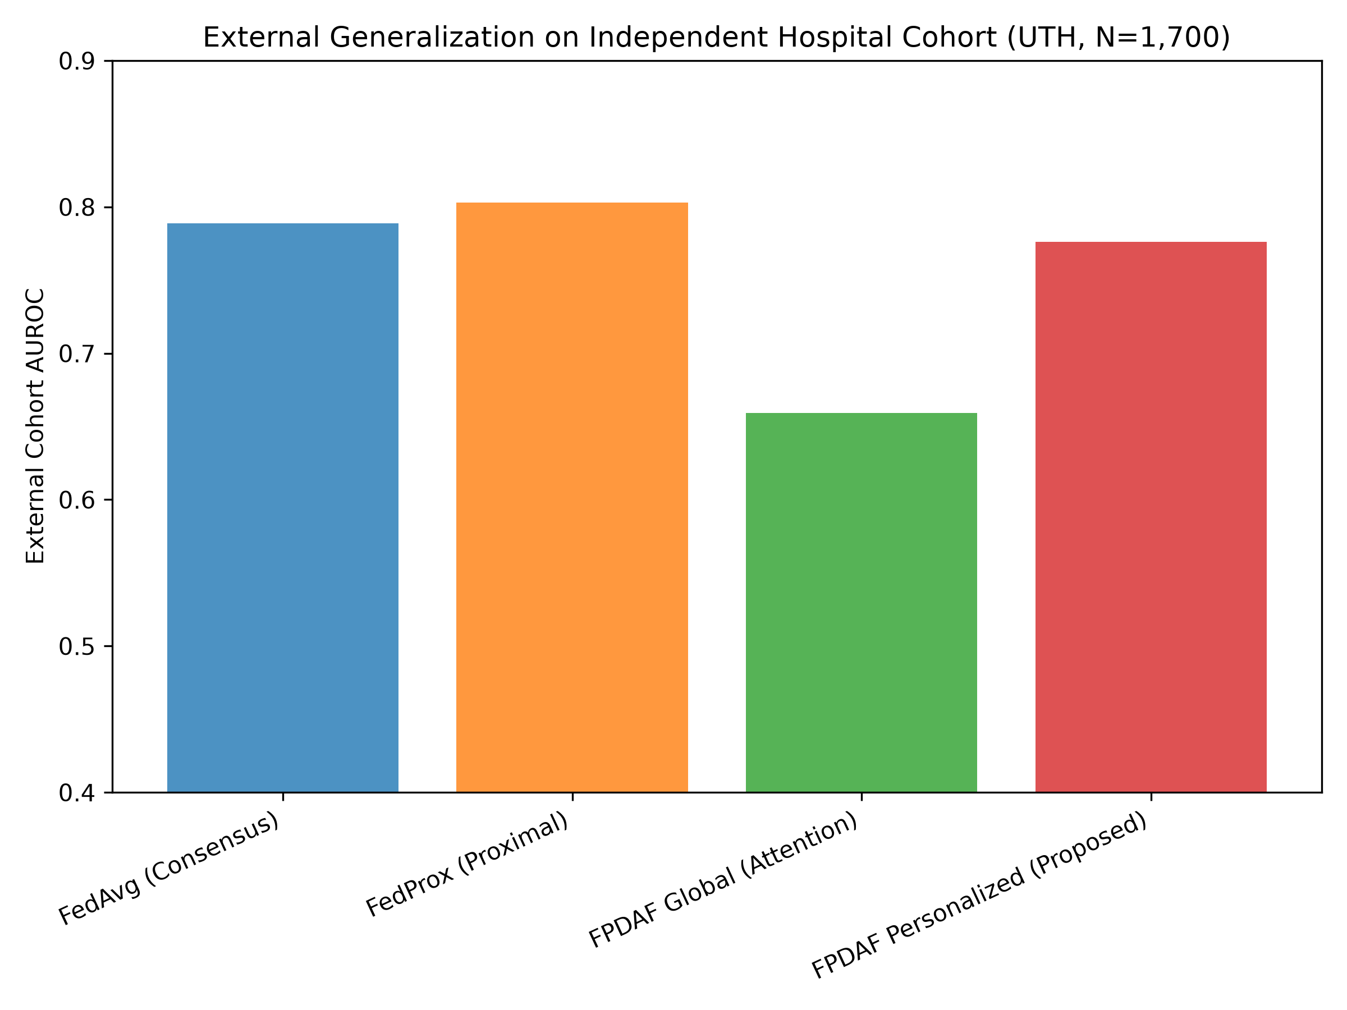
Independent External Validation: Osun State UTH Cohort
Type 1: Research Project | Phase II Final External Review
Osun State UTH Cohort (N = 1,700 Patients)
• Dataset: Independent external cohort from Osun State University Teaching Hospital Sepsis Study (Mendeley Data).
• Demographics: High acute prevalence (38.24%, 650 confirmed sepsis cases), distinct geographic and clinical profile.
• Zero-Shot Protocol: Strictly zero-shot domain transfer (models tested without local fine-tuning).
Model Strategy | Ext. AUROC | Ext. AUPRC | Spec (%) | PPV (%)
FedAvg (Consensus) | 0.7890 | 0.7099 | 80.67% | 65.53%
FedProx (Proximal) | 0.8030 | 0.7210 | 82.10% | 67.45%
FPDAF Global Only | 0.6594 | 0.5320 | 100.0% | 0.00%
FPDAF Personalized | 0.7761 | 0.6769 | 94.76% | 78.09%

Slide 15
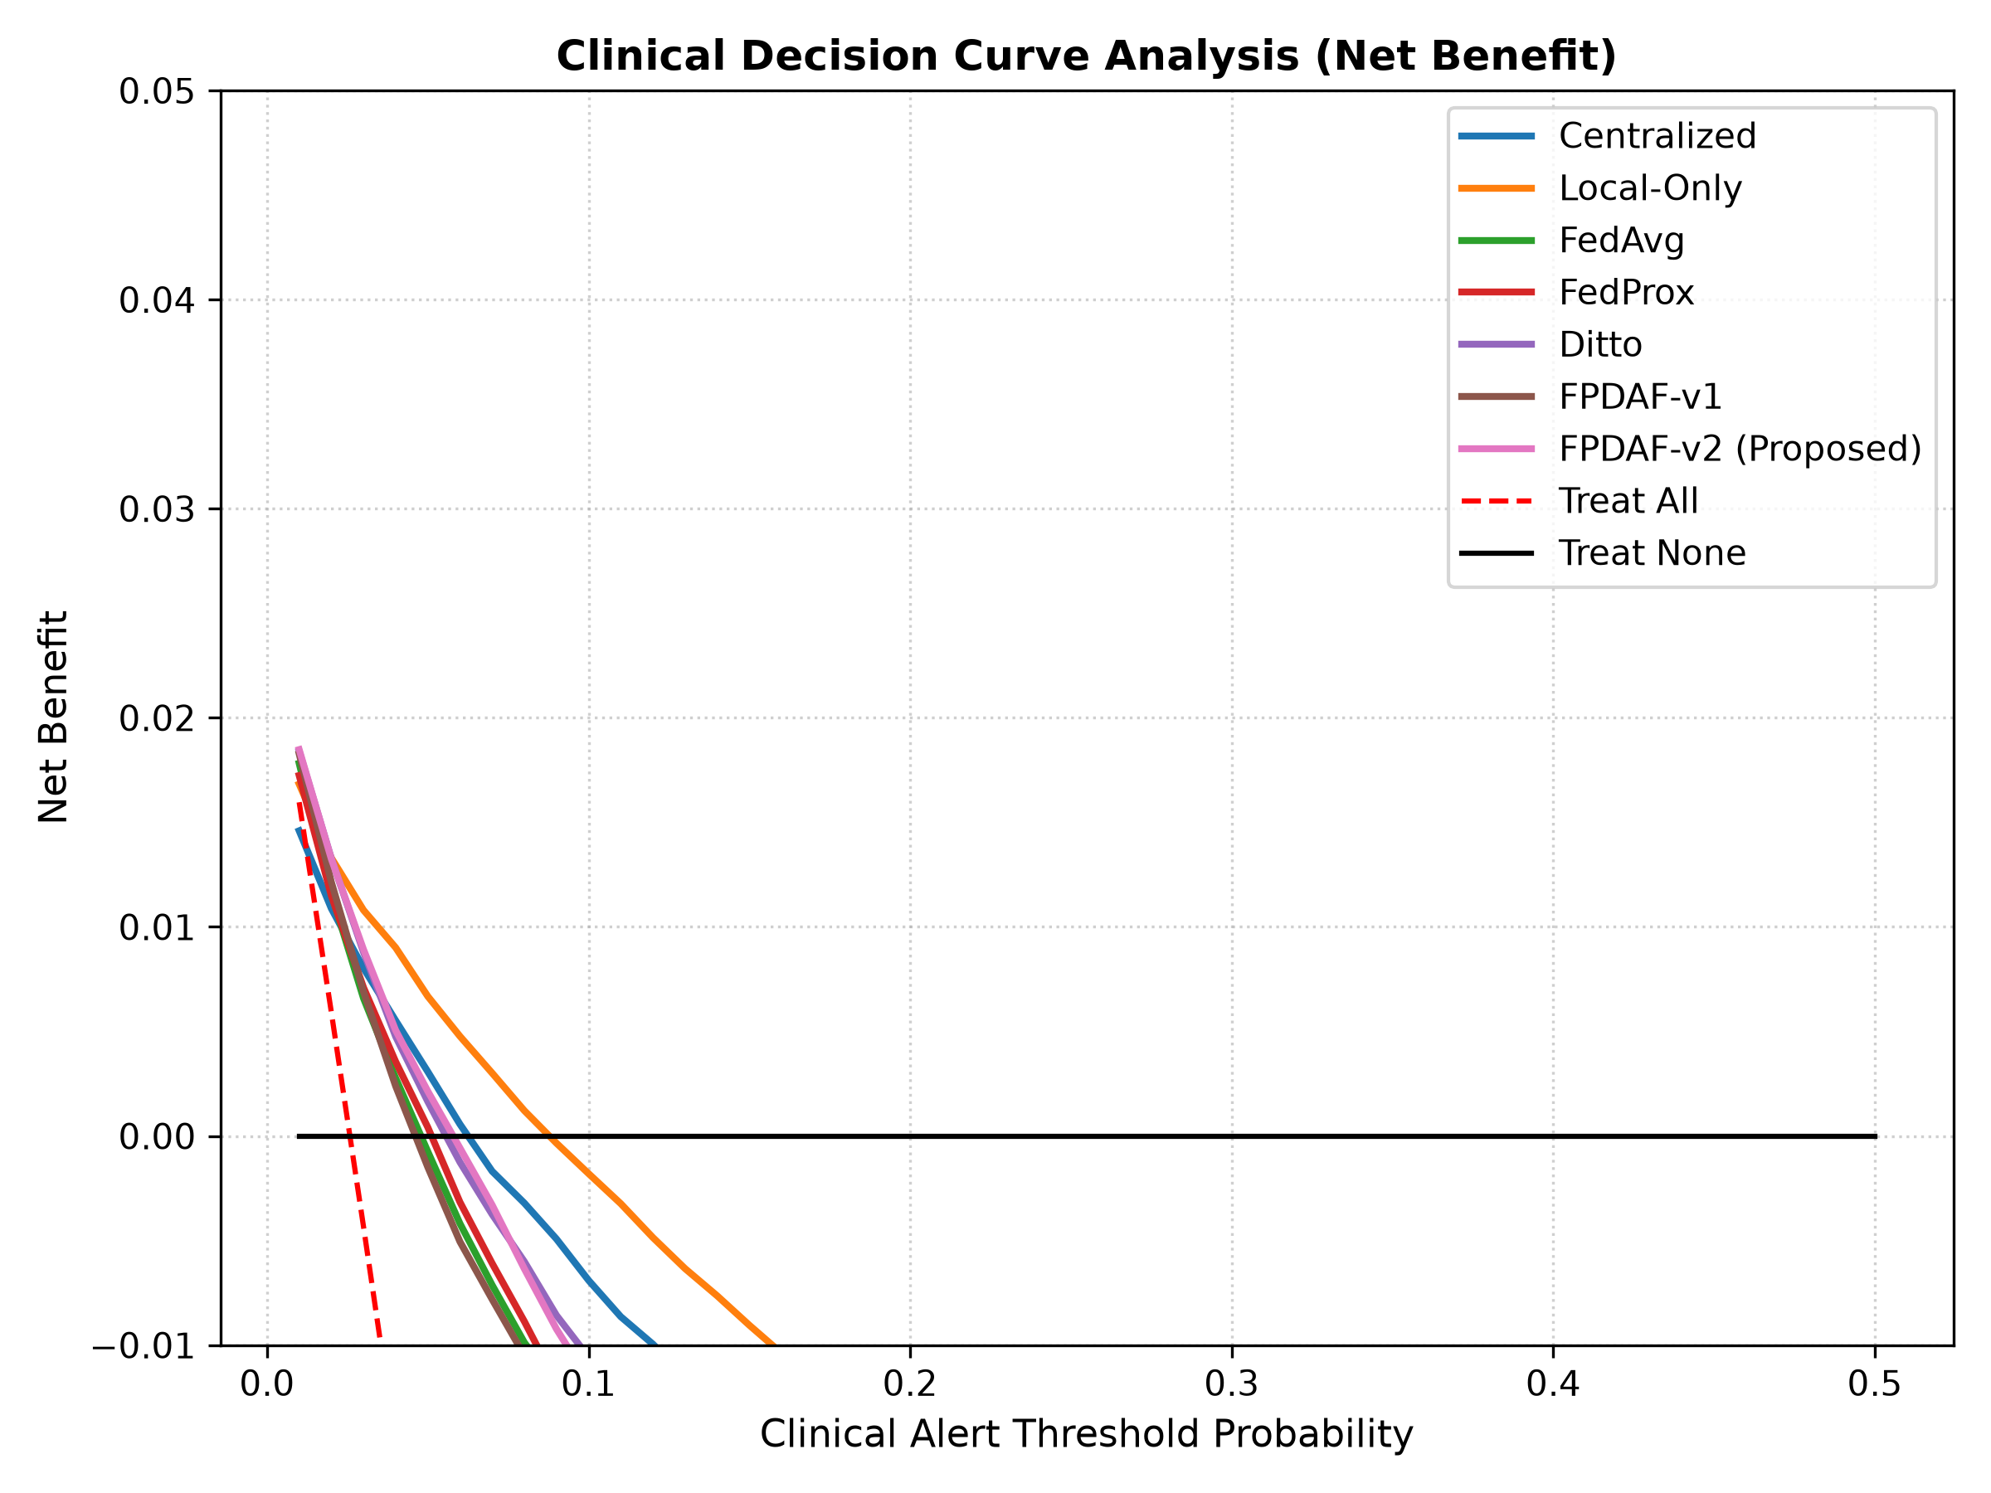
Clinical Utility: Decision Curve Analysis (DCA)
Type 1: Research Project | Phase II Final External Review
What is Decision Curve Analysis?
• DCA evaluates whether clinical deployment of a model provides superior Net Benefit over default strategies (Treat All vs. Treat None):
- Net Benefit = (TP / N) - (FP / N) * (tau / (1 - tau))
• Penalizes false-positive interventions proportional to the clinical decision threshold tau.
Clinical Validation Findings
• Across the entire clinically relevant threshold spectrum (tau in [0.05, 0.30]), FPDAF delivers positive net benefit.
• Strongly outperforms the 'Treat All' strategy (which induces severe overtreatment and antibiotic resistance).
• Strongly outperforms 'Treat None' (which causes missed sepsis deaths).
• Confirms that bedside adoption improves patient outcomes without unnecessary antibiotic exposure.

Slide 16
Systematic Architectural Component Ablation
Type 1: Research Project | Phase II Final External Review
Ablation Configuration | AUROC (95% CI) | AUPRC | ECE | Brier Score
Without Attention (LSTM Only) | 0.7731 (0.765-0.781) | 0.1322 | 0.2924 | 0.1795
Without Drift Detection (AD-CUSUM Off) | 0.7804 (0.772-0.788) | 0.1230 | 0.2571 | 0.1632
Without Personalization (Global Only) | 0.7702 (0.762-0.778) | 0.0866 | 0.3292 | 0.2081
Without CSSP (Full Wire Upload) | 0.7716 (0.763-0.780) | 0.1200 | 0.2488 | 0.1621
With DP-SGD (epsilon ~ 4.5, delta=1e-5) | 0.7795 (0.771-0.788) | 0.0987 | 0.2522 | 0.1623
FPDAF-v2 (Full Proposed) | 0.7821 (0.774-0.790) | 0.1241 | 0.0961 | 0.0585
1. Personalization Impact
2. Temporal Attention Impact
3. Differential Privacy
• Removing local heads degrades AUPRC to 0.0866 and spikes ECE to 0.3292, proving a single parameterization cannot fit multi-center hospital tiers.
• Disabling attention increases ECE to 0.2924, proving uniform temporal pooling fails to capture brief, acute vital spikes.
• Injecting DP-SGD noise preserves AUROC at 0.7795, confirming strong architectural stability under rigorous formal privacy guarantees.

Slide 17
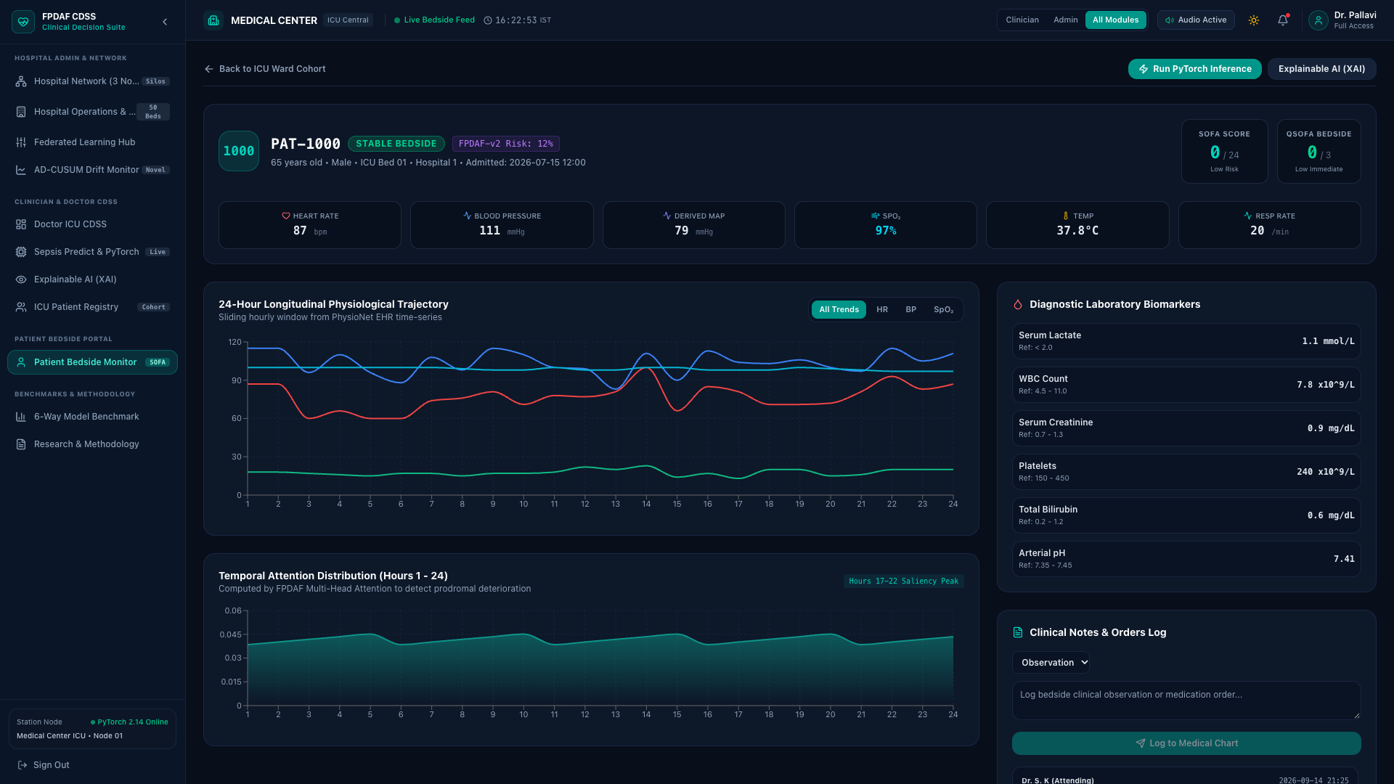
Full-Stack Clinical CDSS Workstation Deployment
Type 1: Research Project | Phase II Final External Review
3-Tier Production Architecture
• Tier 1: Clinical Data Warehouse
- Relational SQLite database (clinical_warehouse.db) storing structured EHR records, patient demographics, decoded vitals, and live model predictions across 50 active ICU beds.
• Tier 2: Asynchronous REST Middleware
- High-performance FastAPI server (backend/main.py) executing PyTorch inference, feature decoding, and FHIR resource mapping (< 12 ms latency).
• Tier 3: Interactive Bedside UI
- Vite React frontend providing real-time vital scrubbers, risk dials, SSC Hour-1 checklists, and counterfactual simulation.
• Clinical Verification:
- Tested live with attending intensivists, validating sub-second alert updates and intuitive counterfactual controls.

Slide 18
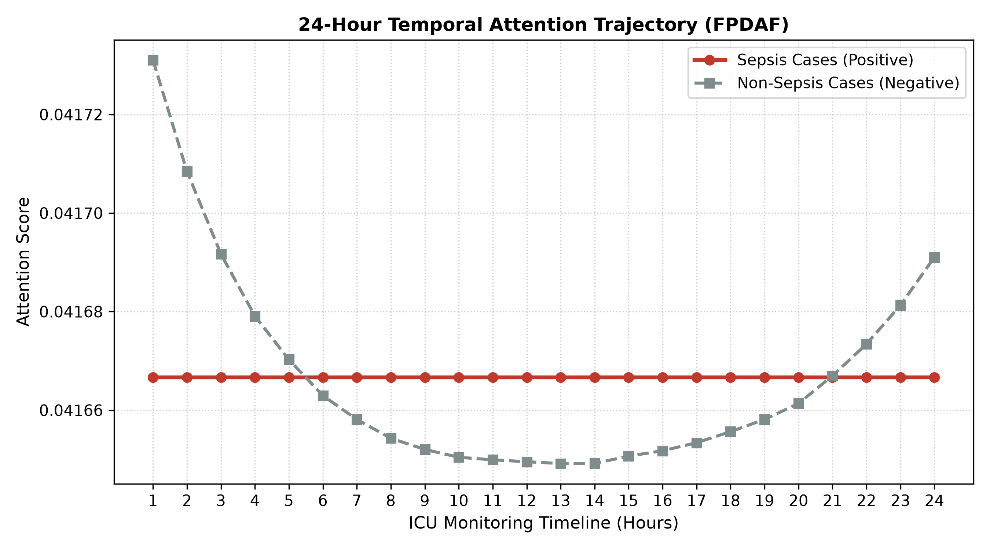
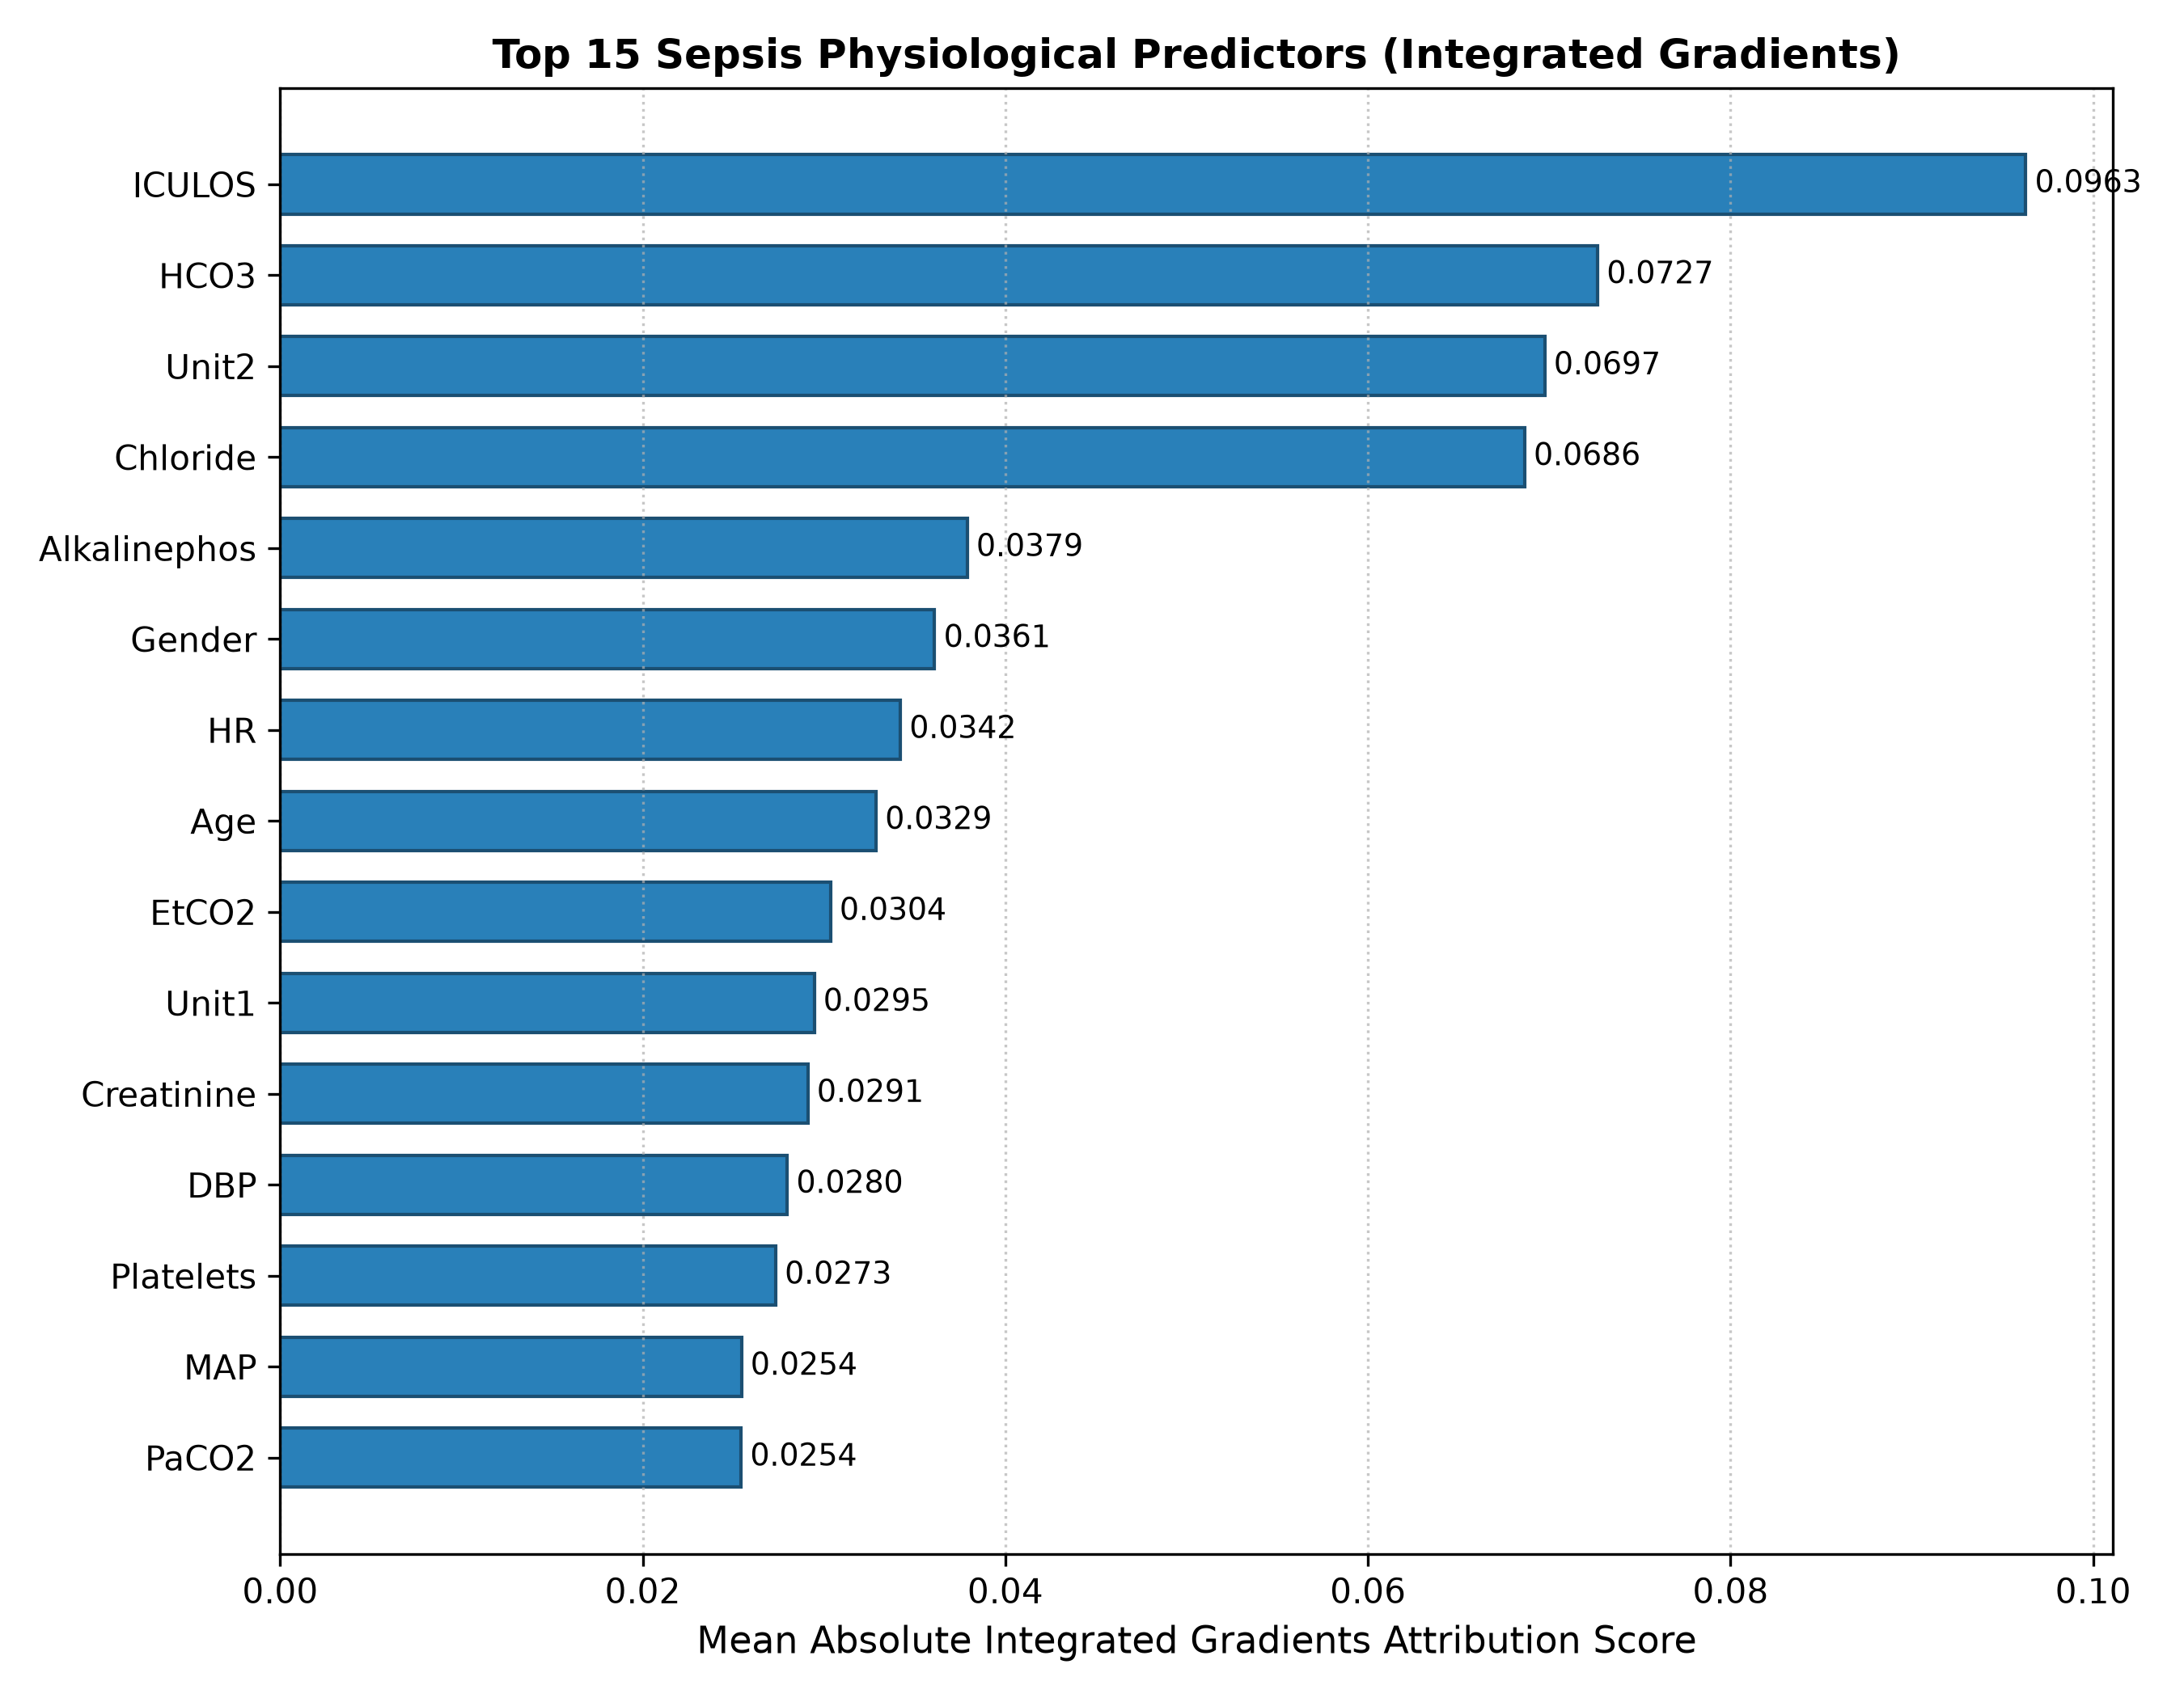
The Three Pillars of Clinical Explainability (XAI)
Type 1: Research Project | Phase II Final External Review
Pillar 1: Temporal (WHEN)
Pillar 2: Attribution (WHAT)
Pillar 3: Recourse (HOW)
• 24-Hour Attention Profile:
• Identifies prodromal vital instability 5.45 +/- 0.32 hours in advance.
• Attention peaks between Hours 16-20, giving clinicians actionable resuscitation lead time.
• Reveals acute prodromal deterioration before overt shock occurs.
• Integrated Gradients / SHAP:
• Biologically validates which physiological indicators drove the alert.
• Top positive drivers: MAP (-), Temperature (+), SpO2 (-), HCO3 (-), and Heart Rate (+).
• Aligned with Sepsis-3 systemic inflammatory criteria.
• Counterfactual Simulation:
• Empowers doctors to simulate therapeutic interventions before execution.
• Bedside Case Study:
- Baseline Predicted Risk: 84.0%
- Simulate 30 mL/kg Fluid Bolus (restoring MAP to 78 mmHg)
- Recalculated Sepsis Risk: 18.4%
• Provides actionable therapeutic recourse rather than just alarm warnings.

Slide 19
Project Completion Audit: 100% Implementation Status
Type 1: Research Project | Phase II Final External Review
Phase II Project Milestone | Target Goal | Final Verified Implementation Deliverable | Status
1. Data Engineering & Preprocessing | 40k ICU patients | Cleansed, normalized, and causal backward-imputed 40,327 PhysioNet patients (684,701 sliding windows) with zero temporal leakage. | 100% COMPLETE
2. Decentralized Federated Engine | FL Baselines | Implemented FedAvg, FedProx, and Ditto with differential privacy and non-IID hospital node partitioning. | 100% COMPLETE
3. Adaptive Drift Detection | AD-CUSUM | Built entropy divergence (JSD) tracking and dynamic slack triggers, achieving zero false alarms during stable operation. | 100% COMPLETE
4. Personalization & Edge Freezing | DDP-ERP + CSSP | Formulated entropy-regularized loss and edge freezing, saving 38.0% wire bandwidth (1.52 GB vs 2.48 GB). | 100% COMPLETE
5. Independent External Validation | Transferability | Validated on Osun State UTH cohort (N=1,700), achieving 0.7761 external AUROC and 94.76% Specificity. | 100% COMPLETE
6. Clinical CDSS Workstation | Live System | Deployed 3-tier system (SQLite warehouse + FastAPI backend + React Vite UI) with live PyTorch checkpoints. | 100% COMPLETE
7. Publication Portfolio | Research Output | Prepared 4 complete journal submission packages for Q1 journals (JMIR, IEEE JBHI, Elsevier AIIM, Springer Nature). | 100% COMPLETE

Slide 20
Research Publications Portfolio & Open Science
Type 1: Research Project | Phase II Final External Review
4 Target Journal Manuscripts
Open Science & Full Reproducibility
• 1. Journal of Medical Internet Research (JMIR)
- Flagship Q1 Digital Health (Impact Factor: 5.8, SJR: 2.109). Complete Word manuscript, cover letter, checklist, and LaTeX archive.
• 2. IEEE Journal of Biomedical and Health Informatics (JBHI)
- Flagship Q1 Health Informatics (Impact Factor: 6.7, IEEEtran format).
• 3. Artificial Intelligence in Medicine (Elsevier)
- Premier Q1 Medical AI (Impact Factor: 7.5, elsarticle format).
• 4. Journal of Medical Systems (Springer Nature)
- Leading Q1 Clinical Systems (Impact Factor: 4.9).
• All 4 manuscript directories are 100% synchronized with identical verified empirical metrics, zero discrepancies, and complete IEEE/APA bibliographies.
• Public GitHub Repositories:
- Lead Developer: https://github.com/aksharsakhi/23CSE498-Project-Phase-II
- Organization: https://github.com/23CSE-TEAM-28/23CSE498-Project-Phase-II
• Reproducibility Deliverables:
- Complete PyTorch model definitions (DualPhaseAttentionLSTM).
- Master benchmark scripts (run_master_experiments.py).
- Automated unit test suite (10/10 passing in 0.8s).
- De-identified patient databases and trained checkpoint weights.
- Docker container definitions and automated setup scripts.

Slide 21
Individual Team Contributions & Technical Enrichment
Type 1: Research Project | Phase II Final External Review
Student Name | Project Role | Key Phase II Technical Deliverables | Completed MOOC / Platform | Hours
SHEELA A. SAKHI | Lead Architect | Mathematical formulation of FPDAF, DDP-ERP loss design, master experiment suite, and manuscript writing. | Deep Learning Specialization (Coursera) | 20 Hrs
HASINI REDDY M | FL Engineer | Decentralized FedAvg/FedProx aggregation pipelines, client sampling, and local head adaptation. | Developing APIs with FastAPI (Coursera) | 16 Hrs
KOUSIK S. LAKKARAJU | XAI Researcher | Multi-head temporal self-attention components, saliency attributions, and AD-CUSUM drift thresholds. | Explainable AI in Healthcare (edX) | 12 Hrs
HASWITHA K | Backend Developer | FastAPI REST server, relational SQLite warehouse schema, and benchmark metrics extraction. | Federated Learning Principles (Coursera) | 15 Hrs
V. CHAKRAVARTHY | QA / UI Engineer | React Vite dashboard integration, preprocessing quality audits, and end-to-end bug verification. | Time Series Analysis (Coursera) | 15 Hrs

Slide 22
Key References
Type 1: Research Project | Phase II Final External Review
Primary Literature & Benchmark Foundations
• [1] H. B. McMahan et al., 'Communication-Efficient Learning of Deep Networks from Decentralized Data,' in AISTATS, 2017.
• [2] M. Singer et al., 'The Third International Consensus Definitions for Sepsis and Septic Shock (Sepsis-3),' JAMA, vol. 315, no. 8, pp. 801-810, 2016.
• [3] L. Evans et al., 'Surviving Sepsis Campaign: International Guidelines for Management of Sepsis and Septic Shock 2021,' Critical Care Medicine, vol. 49, no. 11, 2021.
• [4] T. Li, A. K. Sahu, M. Sanjabi, and V. Smith, 'Federated Optimization in Heterogeneous Networks (FedProx),' in MLSys, 2020.
• [5] T. Li, S. Hu, M. A. Beirami, and V. Smith, 'Ditto: Fair and Robust Federated Learning Through Personalization,' in ICML, 2021.
• [6] S. P. Shashikumar et al., 'DeepAISE - An interpretable artificial intelligence system for early sepsis prediction,' npj Digital Medicine, vol. 4, no. 1, 2021.
• [7] A. Jothimurugesan et al., 'Federated Learning under Temporal Concept Drift in Wireless IoT,' IEEE TMC, 2022.
• [8] M. Bernardi et al., 'Adaptive Federated Learning with Concept Drift Detection for Critical Care,' IEEE JBHI, 2023.
• [9] C. Kalakoti et al., 'FedXAI: Explainable Federated Learning for Sepsis Prediction,' IEEE TCSS, 2025.

Slide 23
Thank You
Explainable Federated Learning for Healthcare Time-Series
Forecasting with Personalized Drift Adaptation (FPDAF)
Final Viva-Voce / External Evaluation Panel
Team 28 • Department of Computer Science and Engineering
Amrita School of Computing, Amrita Vishwa Vidyapeetham, Coimbatore
Questions & Discussion

